Slide 1
Physiological and molecular changes in plants at low temperature
Cold or chilling stress
Fisiologia Molecular do stress
Anabela Bernardes da Silva
Notes:
Play the slide show for this presentation to listen to the audio commentary by Peter Walsh and view slide timings. Or, click the sound icon on a slide for controls that you can use to hear the audio at your own pace.
A little organization will go a long way to enhancing your PowerPoint presentation.
Your title slide should be catching and relevant to your audience – offer something in the title that your audience wants.
Keep some basic principles in mind:
Your slides should complement what you have to say, not say it for you.
Keep slides direct and to the point - less is more!
Choose a background color or design that enhances and complements your presentation rather than competes with it.
Don’t get too fancy - a simple font, elegant color scheme and clear message is more important than lots of information (clutter!) on the slide.
Keep it simple! The purpose of the PowerPoint slide is to keep the mind of your audience focused – fewer words are better.
Note: You understand that Microsoft does not endorse or control the content provided in the following presentation.

Slide 2
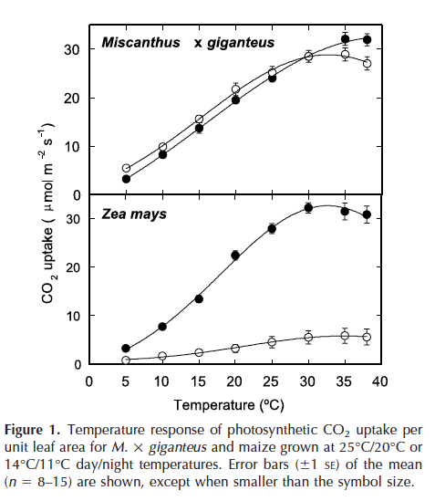
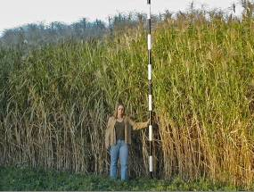
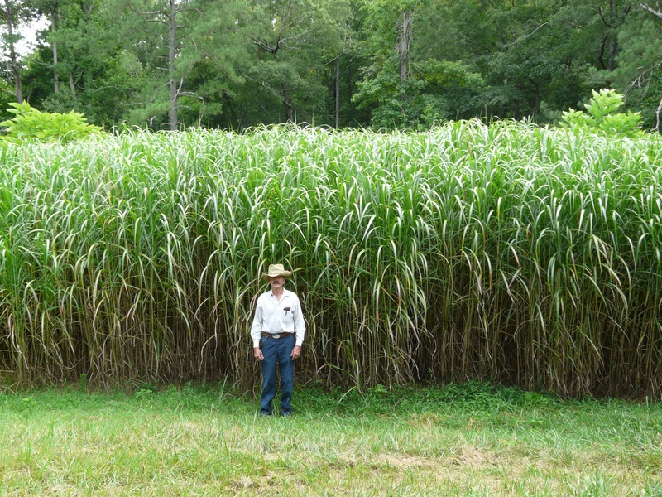
Acclimation to long-term chilling in C4 plants
Effect on photosynthesis
Figure 1. Emily Heaton next to a stand of giant miscanthus on Caveny Farm, Monticello, Illinois.
Each mark on the post equals 1 foot.
Photo: John Caveny.
Naidu et al., Plant Physiol. 132: 1688-1697
Notes:
Miscanthus x giganteus (Greef and Deu.) is a periannual C4 (sub-type NADP-ME) grass, originating in Asia.
Used as ornamental and, more recently, as a biofuel.
Triploide hybrid 2n=3x=57

Slide 3
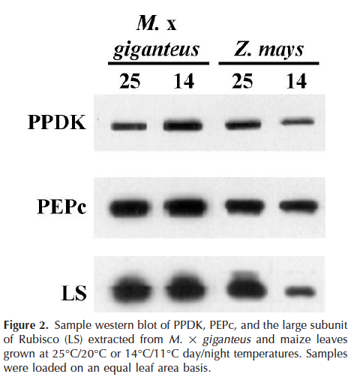
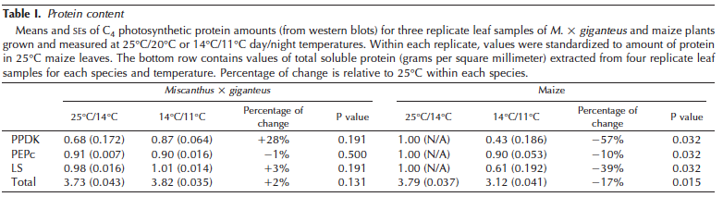
Acclimation to long-term chilling in C4 plants
Effect on photosynthesis
Naidu et al., Plant Physiol. 132: 1688-1697
Notes:
There is an increase in PPDK-protein in Miscanthus (NADP_ME) grown at low temperature.
In corn (NADP_ME), the different content in PPDK-protein and Rubisco LS-protein does not result from a change in the level of transcriptions in steady-state
More protein in Miscanthus. More transcripts? Post-transcription regulation?

Slide 4
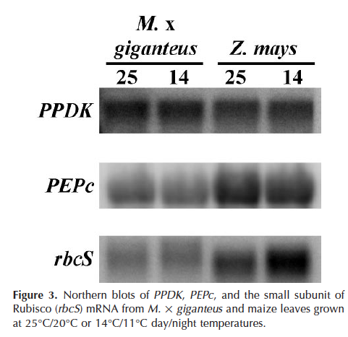
Acclimation to long-term chilling in C4 plants
Effect on photosynthesis
Naidu et al., Plant Physiol. 132: 1688-1697
Notes:
There is no change in the level of transcripts in steady-state
More tenuous bands (less transcripts) of PEPC and RBCS of Miscanthus than corn, because the probes were specific for corn.
For PPDK there was probe for miscanthus
Change in protein turnover: "no more synthesis, but more time is maintained"

Slide 5
Cold or freezing stress in plants at molecular level:
Freezing in maize cultivars
Anabela Bernardes da Silva

Slide 6
Remember…
Freezing stress in plants
3. Primary effects and secondary effects
Reduced cell/leaf expansion
Reduced cellular and metabolic activities
Stomata closure
Photosynthetic inhibition
Altered carbon partitioning
Membrane and protein destabilization
ROS production
Leaf abscission
…
Water potential reduction
Cell dehydration
Symplastic ice crystal formation

Slide 7
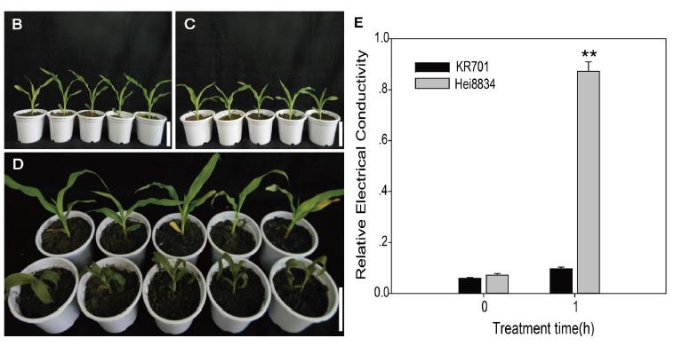

Chilling and freezing stress in plants
Example freezing treatment (-1ºC during 3 h)
Fpls, 2016, Li et al.,

Slide 8
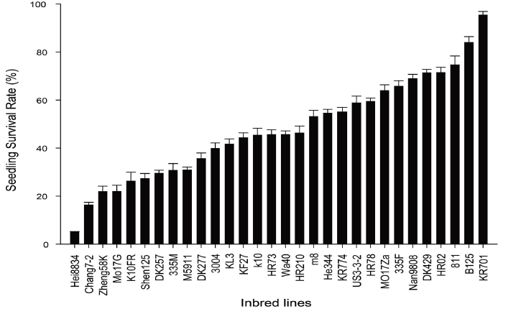
Freezing stress in plants
Example freezing treatment (-1ºC during 3 h) in maize lines
v
v
Fpls, 2016, Li et al.,

Slide 9
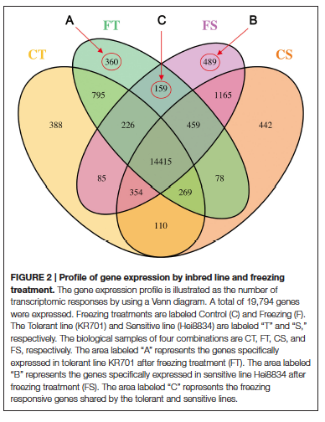
Chilling and freezing stress in plants
Example freezing treatment (-1ºC during 3 h)
C=Control
F=Freezing
T=Tolerant
S=sensitive
19794 genes expressed
795 tolerant line-specific and 1165 sensitive line genes that are not affected by cold treatment
Fpls, 2016, Li et al.,

Slide 10
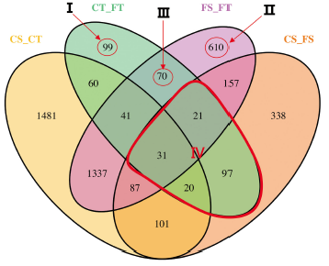
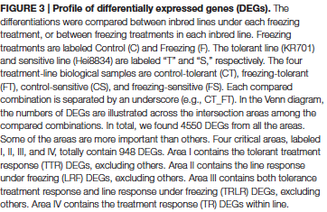
Chilling and freezing stress in plants
2. Example freezing treatment
Areas I,II,III,IV ⬄ line response under freezing
Fpls, 2016, Li et al.,

Slide 11
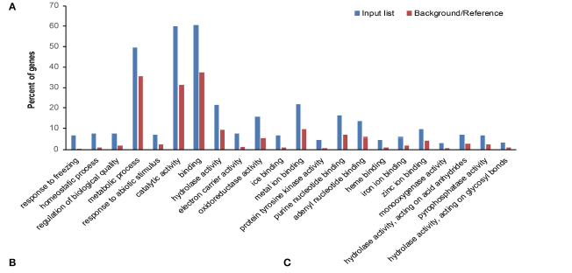

Freezing stress in plants
2. DEGs
Gene Ontology of differentially expressed genes (DEGs) in line response under freezing (LRF).
Fpls, 2016, Li et al.,

Slide 12
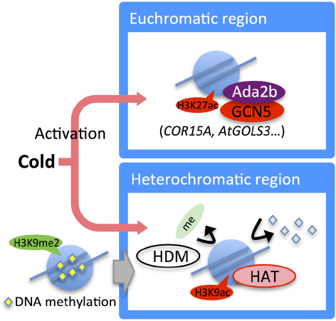
Chromatin changes in response to cold stresses in plants
Figure 4. Epigenetic regulation in the cold stress response. Expression of the HDA6 gene is induced by long-term cold treatment. Under cold stress, the histone acetylation level in cold-responsive genes (e.g., COR15A and AtGolS3) is increased by Ada2b and GCN5. In heterochromatic regions, H3K9me2 is removed and converted to acetylation mark. DNA methylation also decreased.

Slide 13
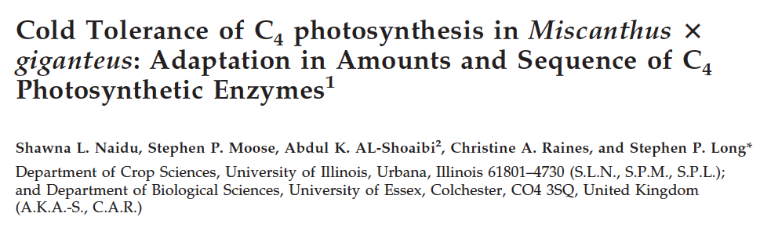
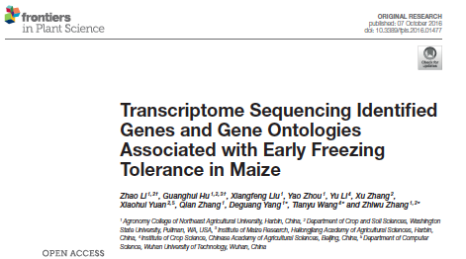
Notes:
- Metabolismo dos carbohidratos
3.Inibição pelo produto
Menor utilização de Açúcares-P, menosPi,
menor actividade ATPase cloroplastos.
Desfasamento do ritmo circadiano da SPS.
Menor mobilização nocturna do amido.

Slide 14
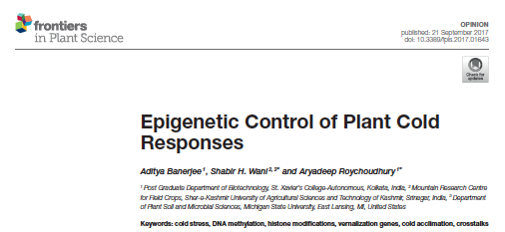
Suggestions :
Notes:
- Metabolismo dos carbohidratos
3.Inibição pelo produto
Menor utilização de Açúcares-P, menosPi,
menor actividade ATPase cloroplastos.
Desfasamento do ritmo circadiano da SPS.
Menor mobilização nocturna do amido.

